Slide 1
Understanding Human Development
Aryal shiva

Slide 2
Concept of Human Development
The term development means a progressive series of changes that occur as a result of maturation and experience.
Development is the pattern of biological ,cognitive and socioemotional change that begins at conception and continues through the life span.

Slide 3
Contd…. Biological and Cognitive Processes
Biological processes – changes in individual’s body; genes and hormones
Cognitive processes – changes in individual’s thought, intelligence, and language

Slide 4
Contd… Socioemotional Processes
Changes in an individual’s emotions, personality, and relationships

Slide 5
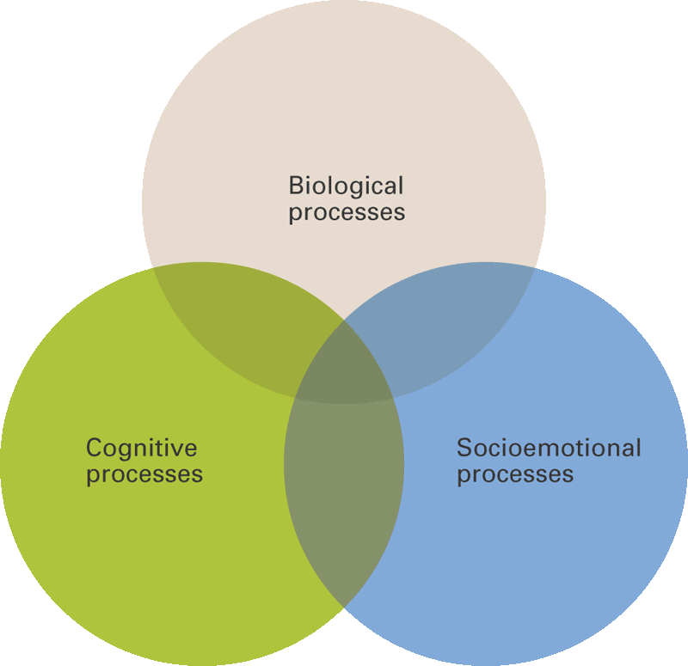
Biological, Cognitive, and Socioemotional Processes
All three processes are intricately intertwined

Slide 6
Characteristics of human development
Early foundation are critically
Role of maturation and learning in development.
Development follows a definite and predictable pattern: Cephalocaudal law :
which maintain that development spread over the body from head to foot.
Proximodistal law:
which maintain that development spread outward from the central axis of the body to the extremities.
All individual are different.
Development builds on earlier learning
Development proceeds at an individual rate.
The different areas of development are interrelated
Each phase of development has hazards.
Development is continuous throughout life

Slide 7
Periods of Development
The prenatal period: it is divided into :
Period of zygote – fertilization to end of second week.
Periods of the Embryo : end of the second week to end of the second month.
Major development : first head region, embryo to turn uterus, Spontaneous movement of the limbs, essentials features of the body both internal and external are establish.
miniature human being.
Average 1\14 ounces
Weight 1\1\2 inces
Periods of the fetus: end of the second month to birth.

Slide 8
Contd…
The time from conception to birth.
From a single cell to an organism complete with a brain and behavioral capabilities.
Approximately a 9-month period

Slide 9
Postnatal periods
Infancy : as a child in the first period of life
Subdivision of infancy:
Period of the partunate : from birth to fifteen to thirty minutes after birth.
Period of the Neonate : from the cutting and tying of the umbilical cord to approximately the end of the second week of postnatal life.
Characteristics of infancy:
The shortest of all developmental periods
Time of radical adjustments: temperature change – 6o to 70F., Breathing, sucking and swallowing and Elimination.
Preview of later development

Slide 10
Contd…

