Slide 1
.
Phenomenology
Phenomenology
Phenomenology

Slide 2
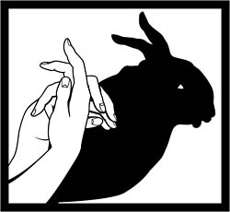
The Form and its Phenomenon

Slide 3
Contd…
How can we distinguish between the
shadow of a rabbit and a rabbit?

Slide 4
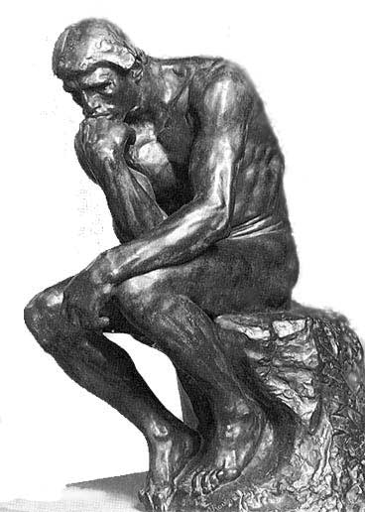
Think its meaning

Slide 5
Possible answer
As what do we experience this hammer? It is many things to many people.
To a carpenter it is a TOOL.
To a retailer it is MERCHANDISE..
To a killer it is a WEAPON.
To a lecturer it is a PROP.
To my girlfriend it is a NUISANCE.
To a communist it is a SYMBOL.

Slide 6
Meaning
Phenomenology is the study of how things appear to consciousness
Phenomenology is an approach which attempts to understand the hidden meanings and the essence of an experience together with how participants make sense of these.” (Grbich 2007, p. 84).
Experience is the source of all knowledge (Husserl).

Slide 7
What do we experience?
Include perception (hearing, seeing, etc.), believing, remembering, deciding, feeling, judging, evaluating, and all experiences of bodily action. Phenomenological descriptions of such things are possible only by turning from things to their meaning, from what is to the nature of what is” (Schwandt, 2001, p. 191).

Slide 8
Contd…
Insist on careful description of ordinary conscious experience of everyday life (the life-world)—a description of ‘things’ (the essential structures of consciousness) as one experiences them” (Schwandt, 2001, p. 191).

Slide 9
Further assumptions
A philosophy without presuppositions – suspend all judgments about what is real.
Intentionality of consciousness – consciousness is always directed toward an object, reality of an object is then related to ones’ consciousness of it.
Refusal of the subject-object dichotomy – without meaning by subject, no reality of object (Creswell, 1998).

Slide 10
Contd…
Phenomenology studies the structure of various types of experience including:
Perception
Thought
Memory
Imagination

Slide 11
Contd…
Describing experiences?
Feelings?
Emotions?
Fantasies?
Dreams?

Slide 12
Key Authors:
Edmund Husserl
Martin Heidegger
Jean-Paul Sartre
Maurice Merleau-Ponty
Max van Manen

Slide 13
Seven Widely Accepted Features
1. Phenomenologists tend to oppose the acceptance of unobservable matters and grand systems erected in speculative thinking;
2. Phenomenologists tend to oppose naturalism (also called objectivism and positivism), which is the worldview growing from modern natural science and technology that has been spreading from Northern Europe since the Renaissance;
3. Positively speaking, phenomenologists tend to justify cognition (and some also evaluation and action) with reference to what Edmund Husserl called Evidenz, which is awareness of a matter itself as disclosed in the most clear, distinct, and adequate way for something of its kind;
4. Phenomenologists tend to believe that not only objects in the natural and cultural worlds, but also ideal objects, such as numbers, and even conscious life itself can be made evident and thus known;

Slide 14
Contd…
5. Phenomenologists tend to hold that inquiry ought to focus upon what might be called "encountering" as it is directed at objects and, correlatively, upon "objects as they are encountered" (this terminology is not widely shared, but the emphasis on a dual problematics and the reflective approach it requires is);
6. Phenomenologists tend to recognize the role of description in universal, a priori, or "eidetic" terms as prior to explanation by means of causes, purposes, or grounds; and
7. Phenomenologists tend to debate whether or not what Husserl calls the transcendental phenomenological epochê and reduction is useful or even possible.

