Slide 1
.
Eastern Philosophy

Slide 2
Eastern Philosophy
The Eastern schools of philosophy may be classified broadly into two Asthika (orthodox) and Nastika ( heterodox). The first group believed in the Vedas and the second school rejected the Vedas. The first one‘s are called the Asthika systems which have the schools of Mimansa, Vedanta, Sankhya, Yoga, Nyaya and Vaisesika. The latter schools are Charvaka, Buddha and Jaina.

Slide 3
Contd…
Eastern philosophies are concerned with all aspects of life. Eastern philosophies both orthodox and heterodox are more concerned with the perennial problems of life. So philosophy is ―Tattva Darshan or vision of life.
As far back as 1500 B.C., we find in the hymns of the Rig Veda, a spirit of inquiry into the nature of things.

Slide 4
Outline of Eastern Philosophy
Vedic Period (2500 B.C. – 600 B.C.)
Epic Period (600 B.C. – 200 A.D.)
Sutra Period (200 A.D. – 600 A.D.)
Scholarly Period (600 A.D. – 1700 A.D.)
The Modern Period (1700 – present)

Slide 5
The Four Vedas
Rig Veda
Yajur Veda
Sama Veda
Atharva Veda

Slide 6
Contd…
The vedas, upanishads, puranas and epics are the sources to know the ancient Eastern philosophy and education. With a view to understand the philosophy of vedas, it is very necessary to understand the meaning of the word ‘veda’. Veda is derived from the root of sanskrit word ‘Vid’.

Slide 7
Contd…
Vid means to :
To know {God, soul, nature & mind}
To be {one with God}
To obtain {salvation}
To consider {various relationships}
To feel {oneness with God}
To tell {glories of God}
To dwell {into the mysteries of universe}

Slide 8
Vedas believe in
The concept of one God and one world
God is one & only one (omniscient, omnipotent and ever present)
There are three entities in this universe – God, Soul and Matter.
Ultimate aim of life is to obtain salvation (moksha) in union with god
Actions are followed by their results. The Law of Karma is an important teaching of Vedas.
This universe is formed by god.
The theory of rebirth and immortality of soul
Universe is real, universal fraternity should be promoted
Knowledge of truth should be acquired and dissipated
Justice should be done to all creatures and we should live in peace & harmony.
Vedas was the basic education during those days.

Slide 9
Mantra
This word is derived from two Sanskrit words:
Manas which refers to the mind
Trayate which means to protect.
Thus mantra is that which protects the mind.
The word trayate also refers to that which reveals, or releases or delivers.
It also refers to the power of reflection of the human mind.

Slide 10
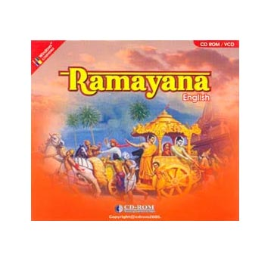
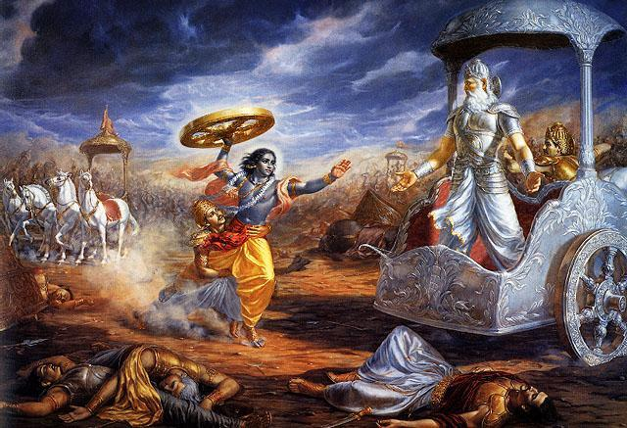
The Epic Period
The Ramayana of Valmiki
The Mahabharata of Vyasa

Slide 11
Sutra Period
Six systems of Philosophy
Nyaya
Vaisesika
Samkhya
Yoga
Purva Mimasa
Uttara Mimamsa or Vedanta

Slide 12
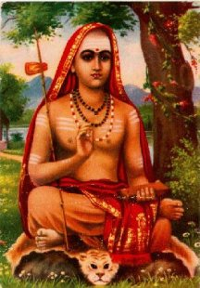
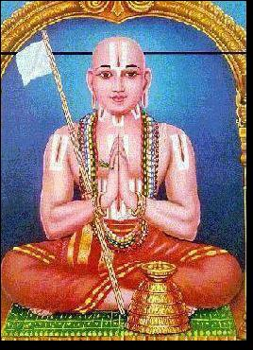
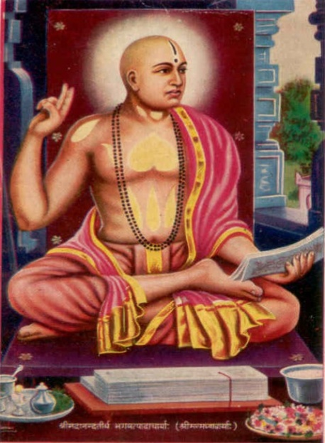
Scholarly Period (600A.D.-1700 A.D.)
Three great philosophers stand out during this period.
They are Shankara, Ramanuja, and Madhva.

Slide 13
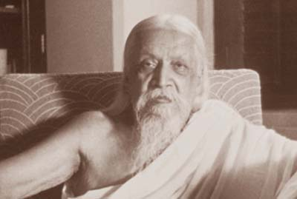
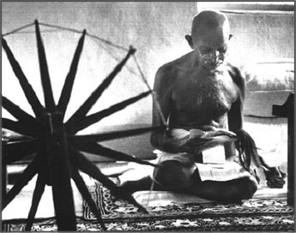
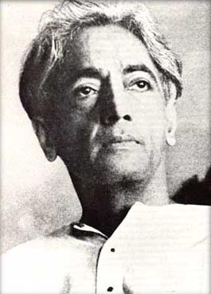
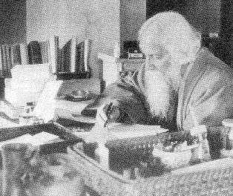
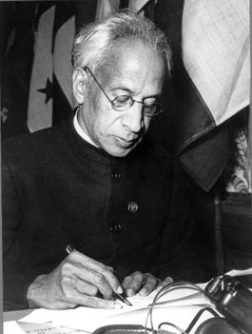
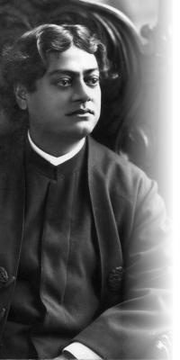
The Modern Period (1700-present)
The writings of the modern period are mainly in English, and so easier to read.
Aurobindo (1872-1950)
M.K. Gandhi (1869-1948)
Krishnamurti (1895-1986
Vivekananda (1863-1902)
R. Tagore (1861-1941)
S. Radhakrishnan (1888-1975

