Slide 1
Behaviorist learning theories
Aryal shiva

Slide 2
Skinnerian conditioning theory of learning.
Operating conditioning (also called instrumentals conditioning) is a forms of learning in which the consequences of behavior produce changes in the probability that the behavior will occur.
Operant condition is at the heart of B.F skinner’s behavioral view . Consequences –reward and punishment –are contingent on the organism’s behavior.

Slide 3
Mechanism of operation conditioning learning
Operant conditioning is correlated with operant behavior. Process of operating conditioning may start with the response as they occur as naturally or random, if they do not occur naturally , then some efforts may be made to bring them as we desire.
Once a response as desired by trainer, it is reinforced through a suitable reinforce – primary, secondary, and positive or negative.
Primary reinforce: in skinner's experiment a pellet of food is positive primary reinforce for the hungry rate.
Secondary reinforce: it may also produce the same result as primary reinforcer. It involves a sorts of neutral stimulus. In skinner’s experiment , the clicking sounds and the lighting of a bulb may act as a secondary or neutral reinforcer . It can be associated with primary reinforcer.

Slide 4
Contd…
The important thing in the mechanism of operant condition is the producing of a desired response and its proper management through suitable reinforcement, here the organism responds in a certain way so as to produces the reinforcing stimulus. The subsequent reinforcement gradually conditions the organism to emit \ produce the desire response and thus learn the desired act.
Shaping : where the desired responses do not occur at random or naturally efforts are directed to bring out the appropriate responses. This is done by building a chain of responses through a step by step process called “shaping”

Slide 5
Contd…
Channing: it refers to a process in the shaping of behavior and the learning of task where the required behavior or task is broken down into small steps for its effective learning and subsequent reinforcement.
Discrimination: the learner picks up the ability to discriminate between stimuli for emitting the learned response. Or Discrimination involves differentiating among stimuli and environment events.
Generalization: In classical conditioning, generalizations is the tendency of a stimulus similar to the conditioned stimulus to produce response similar to the conditioned response. Generalization, In operant conditioning means giving the same response to similar stimuli.eg if the teacher praise the student for asking the good question related to English, will this generalize to harder work in history, math, geography and nepali.
Extension: In operant conditioning, extinction occurs when a previously reinforce response is no longer reinforced and the response decrease. In the classroom, the most common use of extinction is for the teacher to withdraw attention from a behavior that the attention is maintaining. Eg , student disruptive behavior, attendance and so on.
Spontaneous recovery:

Slide 6
Major theoretical concepts –
Radical behaviorism
Respondent and operant behavior
Behavior shaping:
Positive and negative reinforcement:
Contingency contracting.

Slide 7
Types of behavior
Operant behavior
Respondent behavior

Slide 8
Behavior shaping
Reinforcing in each small step of progress toward a desired goal or behavior is behavior shaping. In operant conditioning is also called “science of behavior”.
successive approximation ₊ task analysis + positive practice = Behavior shaping .
successive approximation is a small components that make up complex behavior .
Task analysis: it is a system for breaking down a task hierarchically into basic skills and sub skills.
positive practice :practicing the correct responses immediately after errors.

Slide 9
Contingency contracting
A contract between the teacher and a student specifying what the student must do to earn a particular reward or privilege.
Work listing
Work plan
Plan implementation
Plan completion
Actual completion

Slide 10
Reinforcement and reinforce, punishment and its alternative
Reinforcement (reward): is a consequence that increase the probability that a behavior will occur. For example, you might tell one of your student, “congratulations, I am really proud of the speech that you given”. If the student works harder and speech an even better than now, your positive comments are said to reinforce or reward , the student’s speech behavior.
forms of reinforcement
Reinforce behavior means to strengthen the behavior. Two forms of reinforcement are positive reinforcement and negative reinforcement. In positive reinforcement, the frequency of a response increases because it is followed by a rewarding stimulus through positive comment and parent –teacher conference.
Negative reinforcement: the frequency of a response increase because it is followed by the removal of an aversive or unpleasant stimulus. For example, a father nags at his son to do his homework, He keeps nagging, finally, the son gets tired of hearing the nagging and does his homework. The son’s response( doing his homework) removed the unpleasant stimulus ( unpleasant action)

Slide 11
Contd..
The distinction between positive and negative reinforcement something is added . In negative reinforcement, something is subtracted or removed.

Slide 12
Punishment
Negative reinforcement is often confused with punishment. The process of reinforcement ( positive or negative) always involves strengthening behavior. Punishment involves decreasing or suppressing behavior. A behavior followed by a punisher is less likely to be repeated in similar situations in the future. Again, it is then effect that defines a consequence as punishment.
Any consequence that weakens (decreases the frequency of) a behavior

Slide 13
Forms of punishment
Presentation punishment : decreasing the chances that a behavior will occur again by presenting an aversive stimulus following the behavior, also called type I punishment. Example, teacher assign demerits, extra work and running laps etc.
Removal punishment : decreasing the chances that a behavior will occur again by removing a pleasant stimulus following the behavior, also called type II punishment. Example, teacher and parents take away privileges after a young person has behaved inappropriately or to provide boring task\ chores jobs. they are applying removal punishment.

Slide 14
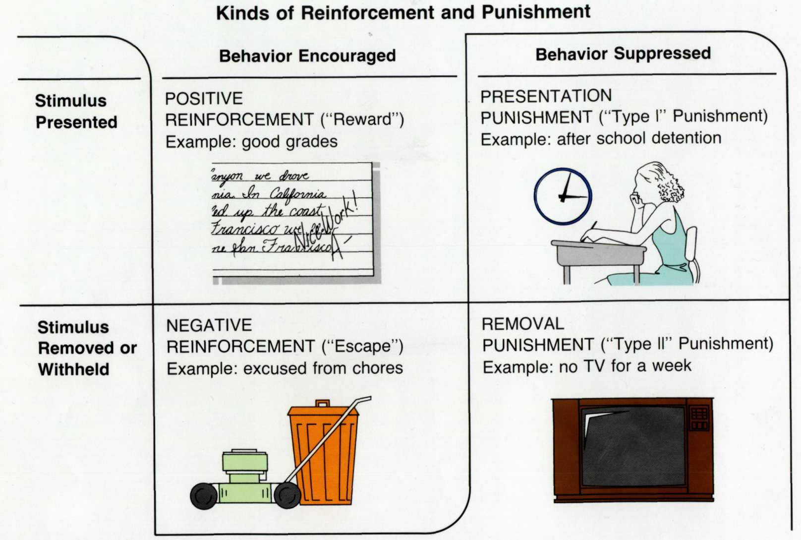
Contd…

Slide 15
Contd…
Antecedent behavior reinforcement
OPERATING CONDITIONING
CONSEQUENCES
EFFECTS
Strengthen the behavior
Repeated behavior
Weakened the behavior
Antecedent
behavior
punishment
Decrease the behavior

Slide 16
Contd…
Antecedents:
Setting Events
Classroom Rules
Classroom Schedule
Room Arrangement
Teacher’s Attitude
Lesson Plan

Slide 17
Reinforcement of schedules
Continuous reinforcement schedules: presenting a reinforcer after every appropriate response.
Intermittent reinforcement schedule: presentencing a reinforce after some but not all Reponses.
Fixed Interval schedule : length of time between reinforcers.
Variables interval schedule:
Fixed ratio: reinforcement base on the number of responses between reinforces.
Variables ratio:

Slide 18
Role of reinforcement
Increasing the desirable behavior:
Choose effective reinforce:
Premack principle: the principle that a high –probability activity can serve as a reinforce for a low –probability activity.
Select the best schedule of reinforcement:
Consider contracting: contracting involves putting reinforcement contingencies in writing.
Use prompt and shaping: prompt means an added stimulus or cue that is given just before a response that increase the probability the response will occur. Shaping means teaching new behaviors by reinforcing successive approximations to a specified target behavior.

Slide 19
Decreasing Undesirable behaviors
Use differential enforcement
Terminate reinforcement(extinction)
Remove desirable stimuli
Resent aversive stimuli ( punishment)

Slide 20
Implications for teaching and learning – Behavior objectives, Programmed instruction, Personalized system of instruction, Contingency contract and Behavior modification.

